Slide 1
AICE Resources Workshop
Presenter: Chad Furman
Contact Information:
Chad Furman
239-377-1435
furmanch@collierschools.com

Slide 2
The purpose of this workshop is to expose teachers to high-quality
resources to support teaching the Pre-AICE and AICE course material.
Teachers will work on their own computers to pull up resources with
the instructor so they are assured future access.
In addition, teachers will also be encouraged to share their own
resources with the group. The goal is to support a district-wide
community of AICE teachers who work together.

Slide 3
Let’s begin by visiting
Mr. Furman’s English website
http://furman.weebly.com

Slide 4
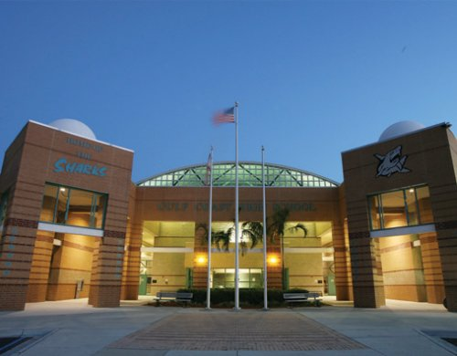
Let’s take a look at Collier County Schools Share Point Resources
GULF COAST HIGH SCHOOL’S AICE WEBSITE

Slide 5
Global Perspectives Resources
GLOBAL PERSPECTIVES:
Cambridge IGCSE® Global Perspectives teacher support
https://global.oup.com/education/secondary/curricula/igcse/global-perspectives/gp/?region=international
Global Perspectives Website Resource List
http://www.slideshare.net/guest2503b46/global-perspectives-website-resource-list-1800258
http://www.aicegladiators.com/global.html
Presents numerous global issues and how they are inter-related
Globalissues.com
Welcome to Cambridge Global Perspectives & Research, AS Level!
https://sites.google.com/a/gm.sbac.edu/jaquish/global-perspectives

Slide 6
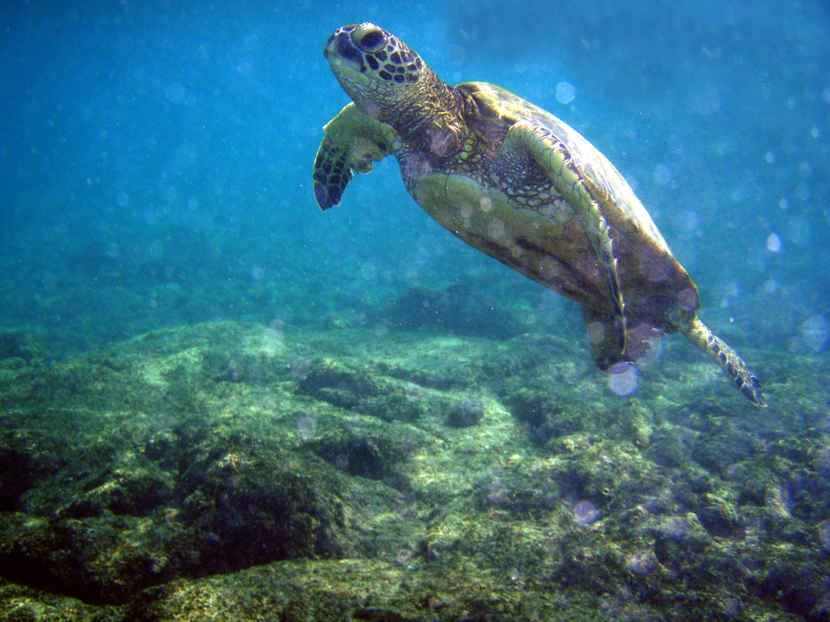
Marine Science Resources
MARINE SCIENCE:
AICE Marine Science Powerpoints...
http://www.mrsbaumansclass.com/aice-marine-science.html
Marine Biology Resource
http://marinebio.org/oceans/arctic-antarctic/
Oxford University Press Science Resources
Chemactive Apps, IB, GCSE & KS3 Resources for Chemistry, Physics and Biology
iGCSE Chemistry, Physics and Biology
Marine Biology Conservation Society
Marine Biology Resource
Marine Biology Live Binder Resource

Slide 7
Thinking Skills Resources
THINKING SKILLS:
AICE Thinking Skills Class Notes
http://teachersites.schoolworld.com/webpages/LHerron/libartsclassnotes.cfm
AICE Thinking Skills Resource
http://dcpspublic.oncoursesystems.com/school/webpage/843386/749916
Quizlet Thinking Skills Flashcards
http://quizlet.com/17919844/aice-critical-thinking-skills-flash-cards/
Excellent Thinking Skills Resource
http://ohsransom.webs.com/aicethinkingskills.htm
Thinking Skills Resource Thinking Skills
Thinking Skills Class Notes Thinking Skills

Slide 8
Modern European History
Resource
EUROPEAN HISTORY:
European History Resource
http://hugheshistory.com/Euro/APResources.htm
Quizlet for European History
http://quizlet.com/subject/aice-european-history/
European History Webquest
http://www.dhr.history.vt.edu/modules/eu/mod04_depression/assignments.html
European History Resource
http://dcpspublic.oncoursesystems.com/school/webpage/593047/774645
American & European History Resources
Digital History Reader
Oxford University Press History teacher support and resources

Slide 9
Spanish Language Resources
AICE SPANISH LANGUAGE:
Spanish Language Resource
http://teacherweb.com/FL/ReaganDoral/MariaCabra/apt3.aspx
AP Spanish Resources
http://tsdwlstandards.wikispaces.com/AP+Spanish+resources
Languages Online
Oxford University Press Modern Languages teacher support and resources
Chez Mimi
StudySpanish.com
Hennings Haus
Language Resources
Live BINDER for pre-AICE/AICE Spanish
Passcode is ccps

Slide 10
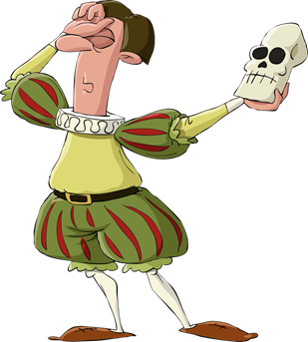
Pre-AICE IGCSE First English Language
IGCSE ENGLISH FIRST LANGUAGE:
Mr. Furman’s PRE-AICE Resources Passcode: GCHS2014
http://furman.weebly.com/pre-aiceaice-program.html
IGCSE Resource for English First Language
https://sites.google.com/site/mrrobertsenglish/
IGCSE First Language English (0500) Resource
http://kiitislibrary.weebly.com/igcse-english.html
IGCSE English First Language Resource
http://huckle-english.wikispaces.com/IGCSE+English+First+Language
IGCSE English First Language
iGCSE English Language Resources
IGCSE English First Language Resource
https://igcse1english.wordpress.com/category/paper-2-question-2-writers-effect/
IGCSE English First Language Resource
http://forword.wikispaces.com/IGCSE+Language+Examination+Skills
IGCSE English First Language and IGCSE English Language Resource
http://henriksenenglish.wikispaces.com/IGCSE
IGCSE English First Language and Literature
Resources and Links for iGCSE Language English and Literature

Slide 11
Pre-AICE IGCSE English Literature
IGCSE ENGLISH LITERATURE:
IGCSE English Literature Resource
http://thedimofdawn.com/
English Literature Skills-Focused GCSE Help
http://www.englishbiz.co.uk/
IGCSE English Literature and First Language
http://igcsey2englishwithmrslee.blogspot.com/2013/04/literature-0500-exam-study-guide.html
IGCSE English Literature Resource
https://thekneelandnexus.wordpress.com/category/igcse-english-lit/
IGCSE English Literature Poetry Resource
http://mskempthorne.weebly.com/poetry-songs-of-ourselves-part-4.html
IGCSE English Literature Resource
https://thekneelandnexus.wordpress.com/igcse-english-literature/
IGCSE English Literature Poetry Resource
https://fxa.showmyhomework.co.uk/school/homeworks/1981057-english-lit-poetry-analysis
IGCSE English Literature Resource
http://literature-igcse.weebly.com/analysis3.html
IGCSE English Literature Excellent Resource
http://divaparekh-igcsehelp.wikispaces.com/English+Literature
IGCSE English Literature GREAT videos on you tube that discuss the poems in the 2014 syllabus
https://www.youtube.com/playlist?list=PLJQeMYLfuzXfgc4Tw1Yt9L7f-2kyftVyS
IGCSE English Literature Resources
iGCSE English Literature Resources

Slide 12
English Language Resources
AICE ENGLISH LANGUAGE:
AICE Language and Global Perspectives Resources
http://sheltonm.com/id32.html
AICE English Language Resource
https://thekneelandnexus.wordpress.com/2013/08/07/aice-english-language-882013/
AICE Language Resource
http://ohsransom.webs.com/aicelanguage.htm
http://www.aicegladiators.com/language.html
AICE English Language Resource
http://henriksenenglish.wikispaces.com/Writing+Skills+and+Techniques

Slide 13
English Literature Resources
AICE ENGLISH LITERATURE:
AICE English Literature Resource
http://divaparekh-igcsehelp.wikispaces.com/English+Literature
AS English Literature Resource
https://thekneelandnexus.wordpress.com/as-english-literature/
AICE English Literature (AS) Level Resources
https://thekneelandnexus.wordpress.com/as-english-literature/
http://classjump.com/d/donohue/?what=classes&class=102989
http://www.aicegladiators.com/literature.html

Slide 14
Media Studies Resources
AICE MEDIA STUDIES:
AICE Media Studies Resource
https://thekneelandnexus.wordpress.com/as-media-studies/
http://petesmediablog.blogspot.co.uk/2012_04_01_archive.html
https://thekneelandnexus.wordpress.com/as-media-studies/
http://www.teachit.co.uk/media-studies

Slide 15
Psychology Resources
AICE PSYCHOLOGY:
AICE Psychology resources
http://quizlet.com/23463991/aice-psychology-study-guide-20-studies-flash-cards/
http://www.holah.karoo.net/corestudies.htm
http://aicepsych.weebly.com/
Passcode: pbcaicepsych

Slide 16
Sociology Resources
AICE SOCIOLOGY:
AICE Sociology Resource
http://classjump.com/d/donohue/?what=classes&class=149787
http://sociology.tranteaches.com/about-aice-sociology/
http://www.asanet.org/introtosociology/TeacherResources/RelevantResourceTable.html

Slide 17
General Paper Resources
AICE GENERAL PAPER:
General Paper Resources
http://www.aicegladiators.com/gen-paper.html
http://theglobalpen.com/gp-literature/
http://generalpaper8004.wikispaces.com/G.P.+Home+Page
General Paper Test Review
http://thegpindie.com/2014/05/05/gp-exam-study-here/

